Slide 1
Predictive Analytics in Basketball
Jacob Hand
12/15/2023

Slide 2
Background
Interest in Prediction Models
NBA Consistency
Various Applications

Slide 3
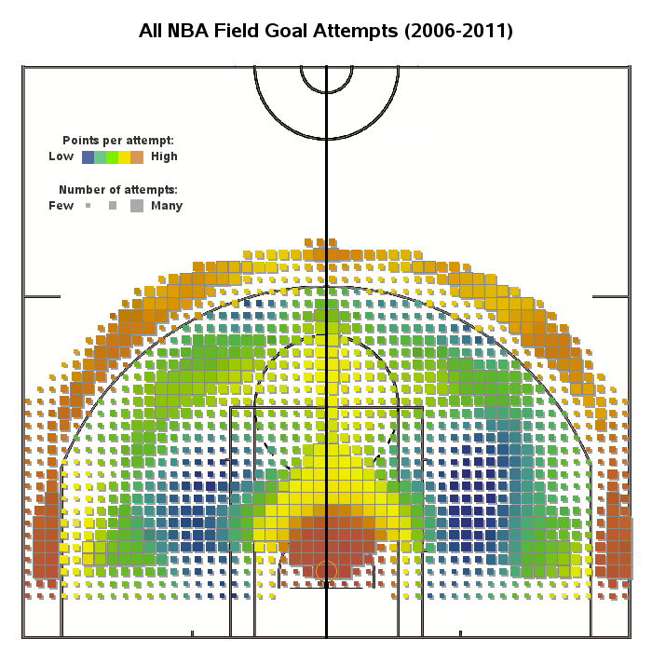
Introduction
Exploring advanced analytics in basketball
Impact on Strategy, fantasy sports, sports betting
Challenge of how dynamic basketball can be
Field Goal Attempts NBA

Slide 4
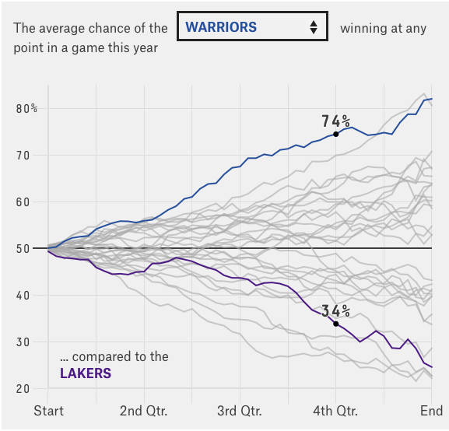
Related Work
Previous public studies on team performance
Few models on player specifics
Private models and sportsbook models exist
Winning Percentage Comparison

Slide 5
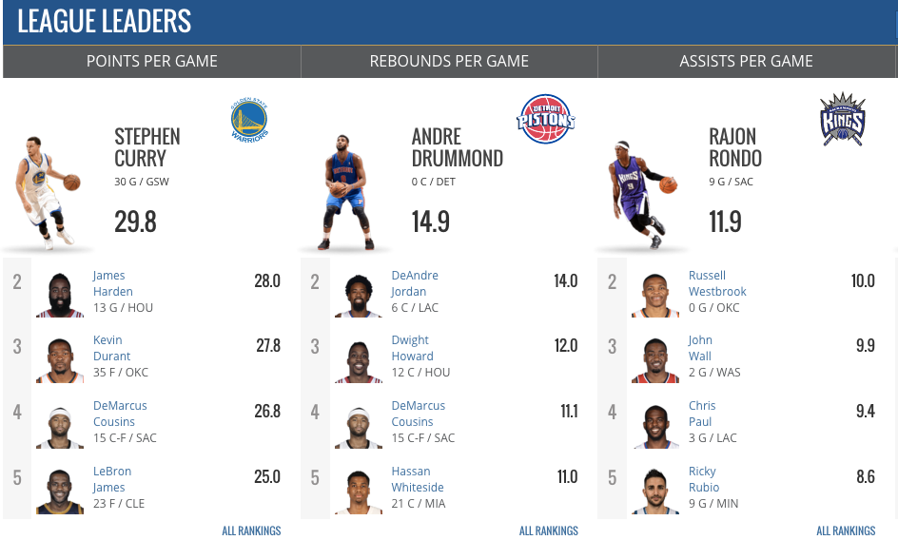
Approach
Adopting a model to capture data relationship
Use previous results to predict future performance
Pick relevant statistics for model
NBA League Leaders

Slide 6
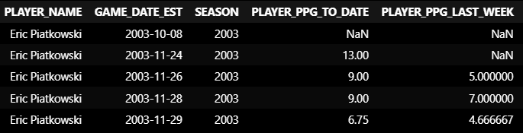
Data Collection and Preprocessing
Kaggle for 2004-2022
NBA API python extension for live data
General preprocessing

Slide 7
Features
Points Per Game
Points Per Game last 3 games
Opponent Defensive strength
Average Minutes Per Game

Slide 8
Models Tested

Slide 9
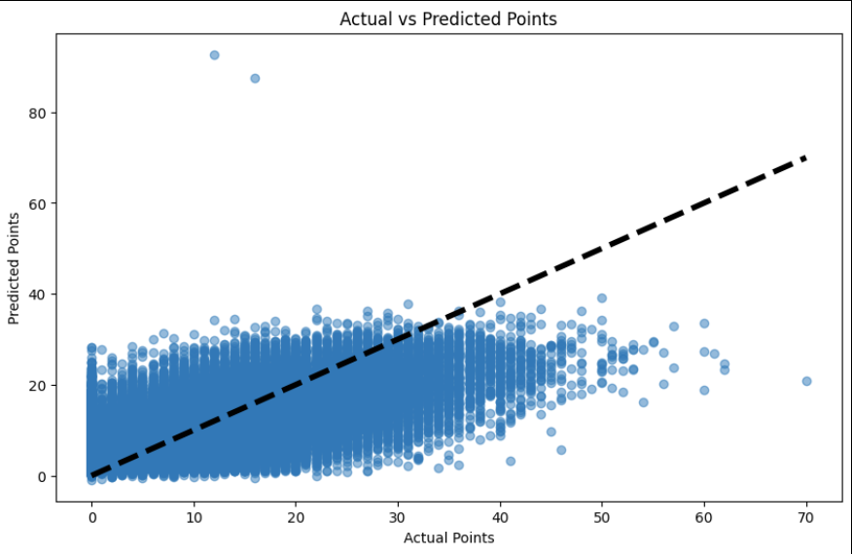
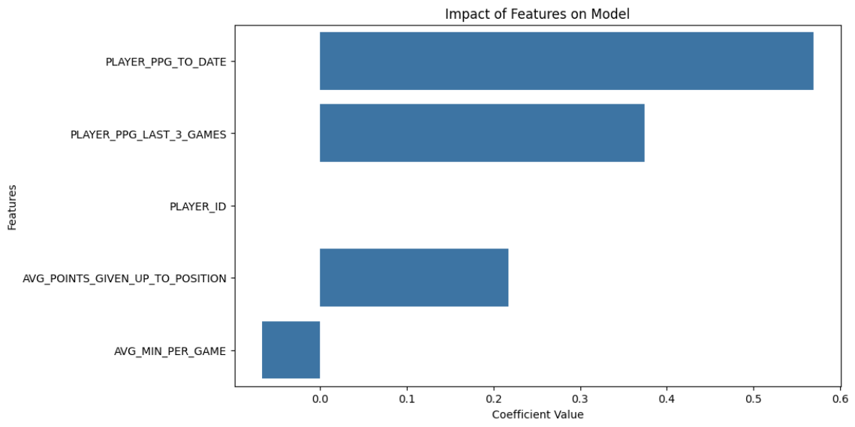
Linear Regression
Percentage of predictions within ±3 points of actual values: 49.13%
Mean Squared Error: 31.12
Root Mean Squared Error: 5.57
Notes:
Baseline Model
Assume linear relationship
Easy model to visualize and use

Slide 10
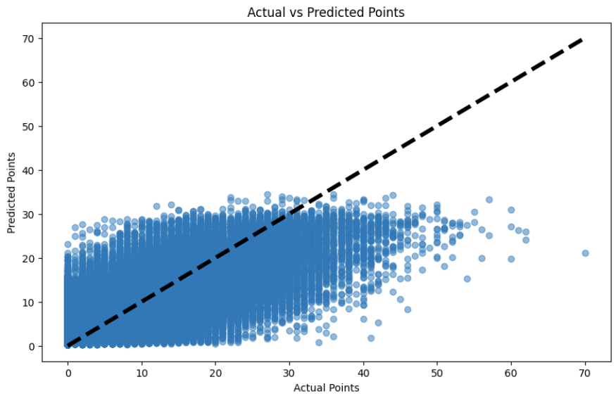
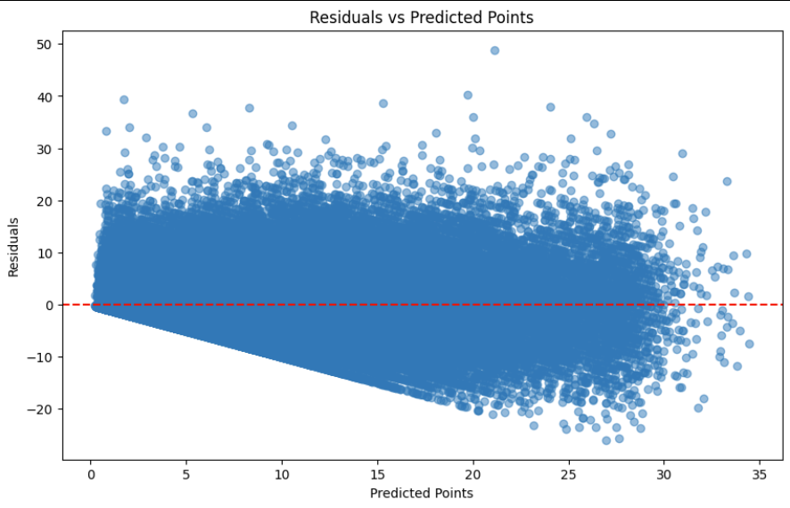
K-Nearest Neighbors
Mean Squared Error: 29.57
Root Mean Squared Error: 5.43
Notes:
Instance-Based Learning: KNN is an instance-based learning algorithm, meaning it uses the specific instances (or examples) of the training data to make predictions, rather than deriving a generalizable function from the training data.
Neighbors Concept: The 'K' in KNN stands for the number of nearest neighbors the algorithm considers when making a prediction. It looks at the 'K' closest data points (or neighbors) in the feature space to the point being predicted.

Slide 11
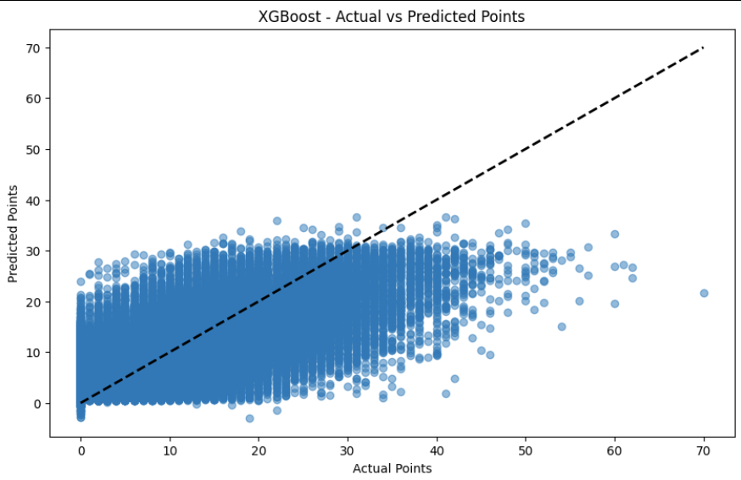
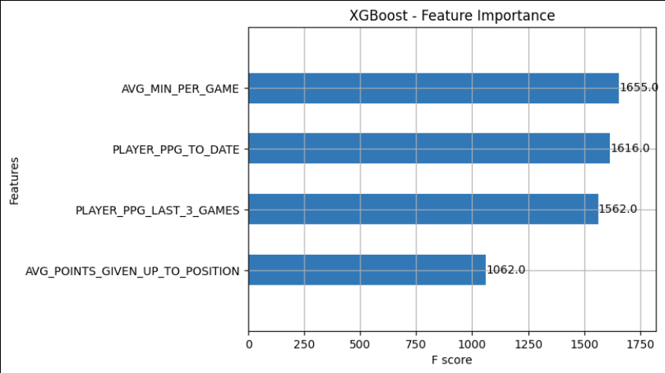
XGBoost
Model Mean Squared Error: 29.64
Model Root Mean Squared Error: 5.44
Notes:
F score means frequency of feature used in splitting
XG boost uses decision trees that learn based on previous trees to try to improve accuracy
objective='reg:squarederror',
colsample_bytree=0.5,
learning_rate=0.1,
max_depth=5,
alpha=15,
n_estimators=200

Slide 12

Model Comparison
Very Similar RMSE
Models vary by 5.5 points on average
KNN and XGBoost tend to highly overestimate point scoring
Linear Regression 50% of predictions within 3 points
Notes:
KNN and XGBoost have most error among non starting players since the data is trained mainly among starters based on how the input data is structured.

Slide 13
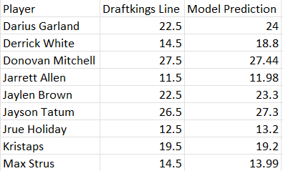
Application
Example of Sports Betting
Sportsbook accuracy is usually high
Good way to evaluate model

Slide 14
Conclusion
Modeling shows potential in application
Future Development
New Features
Different Models
Condensed Data

Slide 15

Questions

